Slide 1
SYSTEMS
ANALYSIS AND DESIGN
Nguyen Thanh Binh, Nguyen Quang Vu, Le Viet Truong, Nguyen Thi Hanh, Vo Van Luong, Le Thi Bich Tra
Faculty of Computer Science

Slide 2
An overview of Unified modeling language
Modeling concept
Object-oriented modeling techniques
History of UML
Brief introduction to UML
  Notions
  Diagrams
  Views

Slide 3



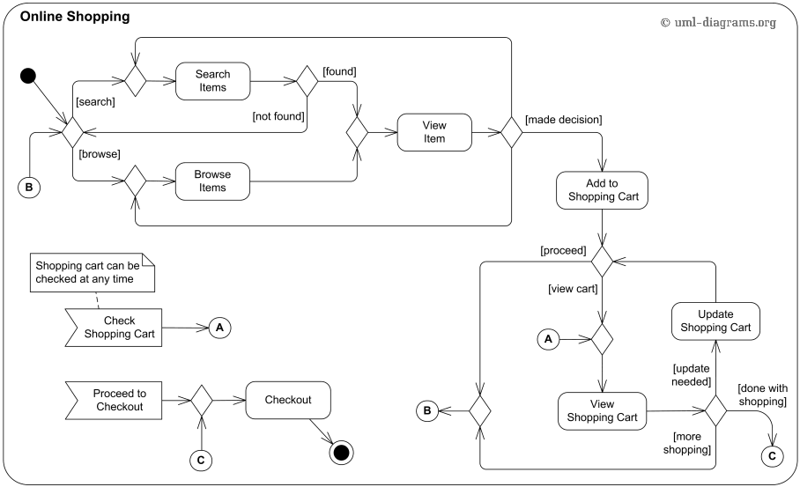
Model and modeling
A model is a simplification of reality. We build models so we can better understand the system we are developing.
Modeling is the process of building models to represent a system
Modeling
  helps us to visualise a system as it is or as we want it to be
  allows us to specify the structure or behaviour of a system
  gives us a template that guides us in constructing a system
  documents the decision we have made

Slide 4
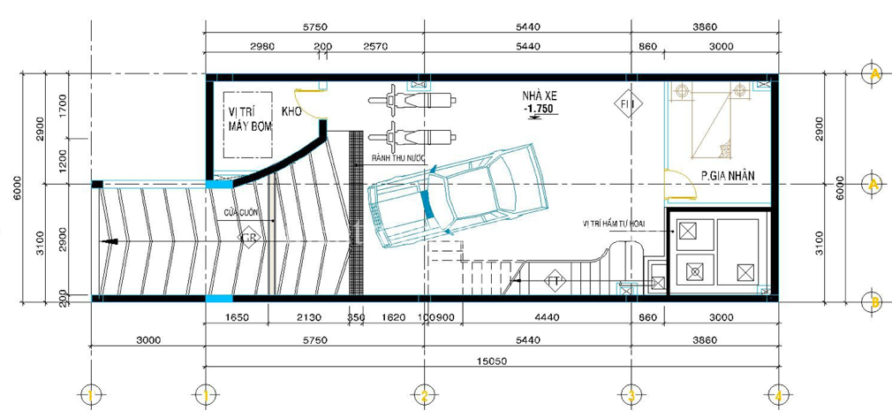

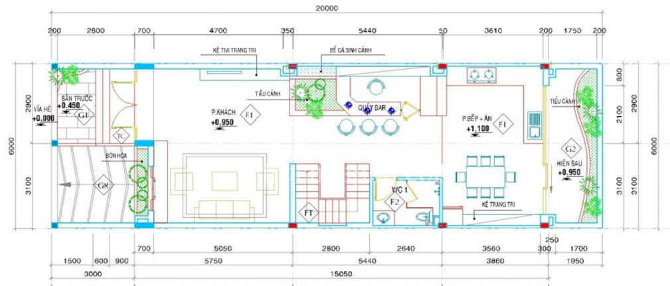
Model and modeling: Example

Slide 5
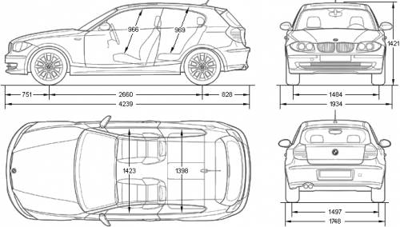
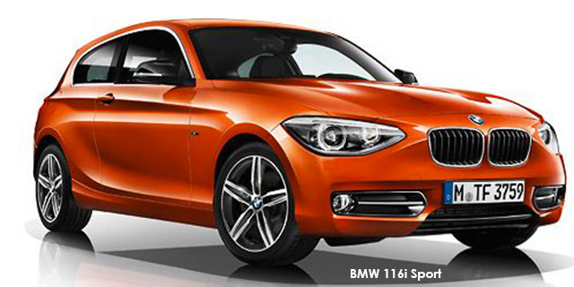
Model and modeling: Example

Slide 6
Modeling
A model is a simple representation of a part of the real system with a specific purpose
  The actual system is complex, then it is necessary to simplify
  Master the complexity of the system
A model represents the system
  at certain abstraction level,
  according to a viewpoint,
  by means of description (e.g., text, image, …)

Slide 7
Modeling: why?
Better understand the system
  Facilitate the master the problem
Ease the communication
  Supply means of communication between developers
Better complete the system
  Ease the recognition of consistency between models and the needs to improve and complete the system
Specify the structure and the behaviour of the system
Document the important decisions

Slide 8
Modeling
Meta-model
  is a representation of a model
  can be used to
    describe the syntax and the semantic of a model
    manipulate models with tools
    transform models
    verify and maintain the coherence between models

Slide 9
Principles of modeling
The choice of the appropriate model
  Data view: entity-association model
  Structural view: algorithm
  Object-oriented view: classes and relations between them
The models must represent the system at different levels of abstraction (according to the needs of the users)
Models must be connected to the real world
  Constructed models are close to real systems
  Object approach > Procedural approach
A system must be modelled by a set of models
  A model is not sufficient
  Describe different views of the systems: dynamic, static, installation, use, …

Slide 10
Modeling
A good model should
  use a standardized notation
  be understandable for customers and users
  allow software developers to understand the system
  provide an abstract view of the software
  be visual

Slide 11
Benefits of modeling
Ease the revision and the evolution of the system
Reduce errors by allowing to detect errors early in the stages of development
Reduce development cost
Reduce time-to-market
Reduce complexity by mechanism of abstraction

Slide 12
Object-oriented modeling techniques
Object-oriented modeling techniques are processes/methodologies/approaches for software modeling and designing
  1975 - 1990: several object-oriented techniques are developed
  1990 - 1994: there are more than 50 object-oriented modeling techniques
Best-known techniques
  OOD (Object-Oriented Design)
  OOSE (Object-Oriented Software Engineering)
  OMT (Object Modeling Technique)

Slide 13
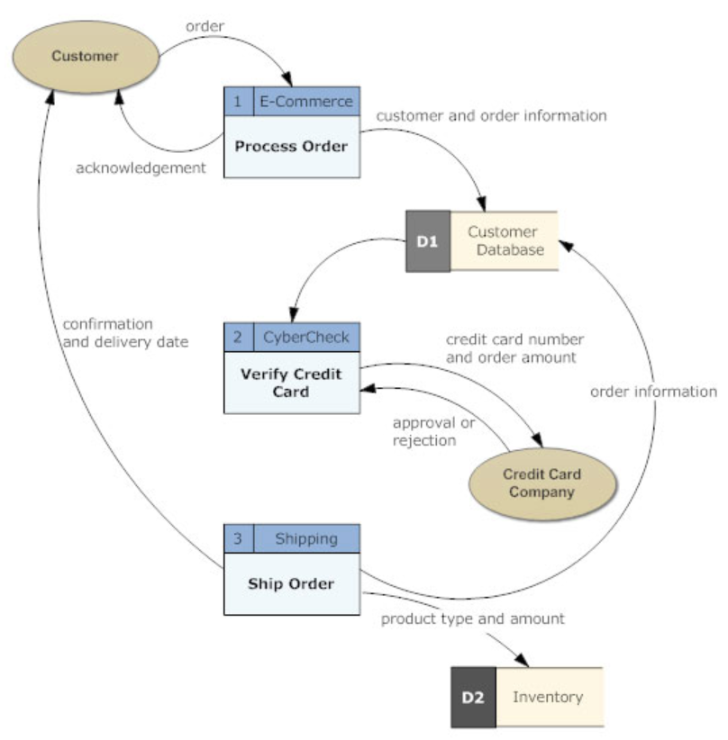
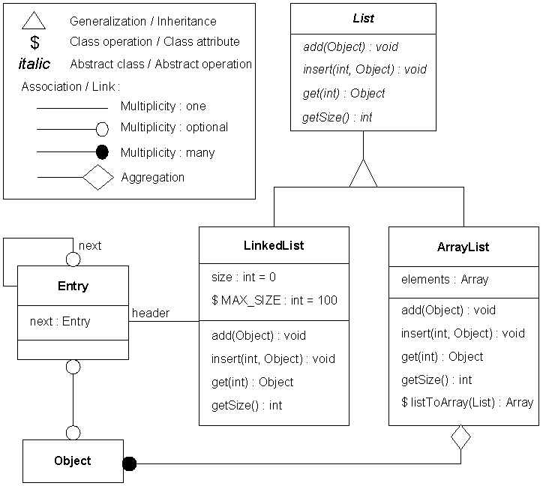
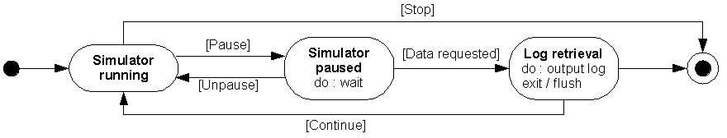
OMT technique
Developed by Jim Rumbaugh (1991)
Consists of 3 main types of models
  Object model: Object diagram
  Dynamic model: State diagram
  Functional model: Data flow diagram
OMT Data flow Diagram
OMT Object Diagram
OMT State Diagram

Slide 14
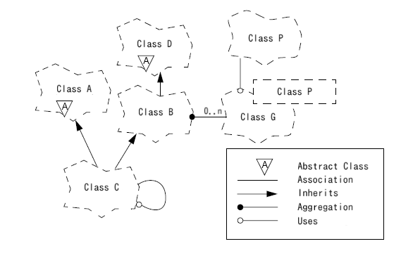
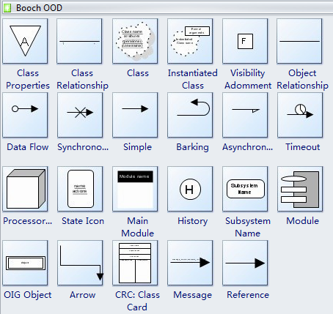
OOD technique
Developed by Grady Booch (1991)
Consists of
Static view
  Class diagram
  Object diagram
  Module diagram
Dynamic view
  State transition diagram
  Process diagram
  Interaction diagram

Slide 15
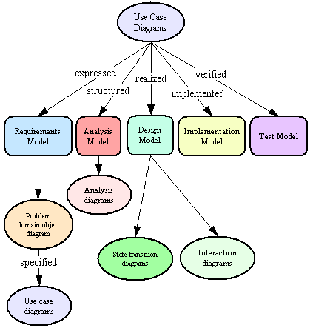
OOSE technique
Developed by Ivar Jacobson (1992)
Consists of 5 models
  Requirements model: Problem domain diagram, Use-case diagram
  Analysis model: Analysis diagram
  Design model: State transition diagrams, Interaction diagrams
  Implementation model
  Test model

Slide 16
History of UML
Too many object-oriented modeling techniques
  Need for standardisation
    Unification of modeling techniques
In 1994
  Rumbaugh and Booch unified their approaches for the UML project at Rational Software
In 1995
  The first version was released under the name “Unified Method” v0.8
In 1996
  Jacobson joined the team
In 1997
  The birth of UML v0.9 integrating OOSE
  The first conference of the UML is organized
In 2005, UML 2.0 is released
  New diagrams, enhancement of existing diagrams
In September, 2013, UML v.2.5 RTF - Beta 2
In June, 2015, UML v.2.5

Slide 17

History of UML
Contributions to UML
HP Fusion
Description of operations,
numbering messages
Harel
Finite state machine
Gamma
Framework, patterns
Wirfs-Brock
Responsabilities
Booch
OOD
Rumbaugh
OMT
Shlear-Mellor
Life cycle of objects
Jacobson
OOSE
Embley
Singleton classes,
Composite objects
Myers
Pre and post-conditions
Odell
Classification

Slide 18
Introduction to UML
UML (Unified Modeling Language) is a modeling language
  consisting of the vocabulary, syntax and semantics
  allowing to represent a system at different levels: conceptual, physical
  consisting of vocabulary and rules to describe different models representing a system
UML
  is neither a methodology nor a process
  allows freedom of design
  can be combined with several development processes

Slide 19
Introduction to UML
UML is a language of visualisation
  using graphical representations
  providing a better view of the system (thanks to graphical representations)
UML is a language of specification
  allowing to specify a system without ambiguity
  allowing to specify a system at different stages: analysis, design, deployment
UML is a language of construction
  allowing to simulate the system
  UML models are easily transformed into source code
UML is a language of documentation
  allowing to describe all the development stages of the system
  Built models are complete documents of the system

Slide 20
Introduction to UML: the diagrams
Consisting of 10 main diagrams
  Requirements modeling
    Use-case diagrams
  Static structural modeling
    Class diagrams
    Object diagrams
  Dynamic behavioral modeling
    Interaction diagrams
      Sequence diagrams
      Communication diagrams
    Activity diagrams
    State diagrams
  Architectural modeling
    Package diagrams
    Component diagrams
    Deployment diagrams

Slide 21
Introduction to UML: Use-case diagram
Showing the possible uses of a system
Describing the static view of the system according to users perspective
Being very important to understand the functions of the system
Example
UserManagement
add user
delete user
admin
<<use>>
find user
modify user

Slide 22
Introduction to UML: class diagram
Describing the classes and their relationship
Describing the static view of the system
Example
Polygon
Parallelogram
Triangle
Rectangle
Lozenge
Square

Slide 23
Introduction to UML: object diagram
Describing a set of objects and their relationship
An object diagram represents the same information that a class diagram but at the instance level of classes
Describing the static view of the system
Example
Class diagram
University
Faculty
CS:Faculty
VKU:University
CE:Faculty
Object diagram
DE:Faculty

Slide 24
Introduction to UML: interaction diagram
Describing the behaviours of the system by the interactions between the composing objects
modeling the dynamic view of the system
The interaction diagram is an extension of the object diagram by describing the interactions between objects
Consisting of two types of diagrams
  Sequence Diagram describes the interactions between objects with the emphasis on sequencing of messages
  Communitaion Diagram describes the interactions between objects with the emphasis on the structure of objects

Slide 25
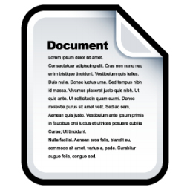

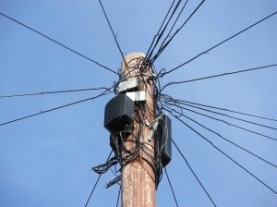
Introduction to UML: interaction diagram
Sequence Diagram example
:Document
:Fax
:TelephoneLine
call()
call()
invitedSound
compose(num)
compose
connected
send(page)
transfer(page)
“Sending Fax” Sequence Diagram

Slide 26
Introduction to UML: interaction diagram
Communication diagram example
1.1: call()
1.3: compose(num)
3.1: transfer(page)
1: call()
3: send(page)
:Document
:Fax
:TelephoneLine
2: connected()
1.2: invitedSound()
1.4: connected
“Sending Fax” Communication diagram

Slide 27
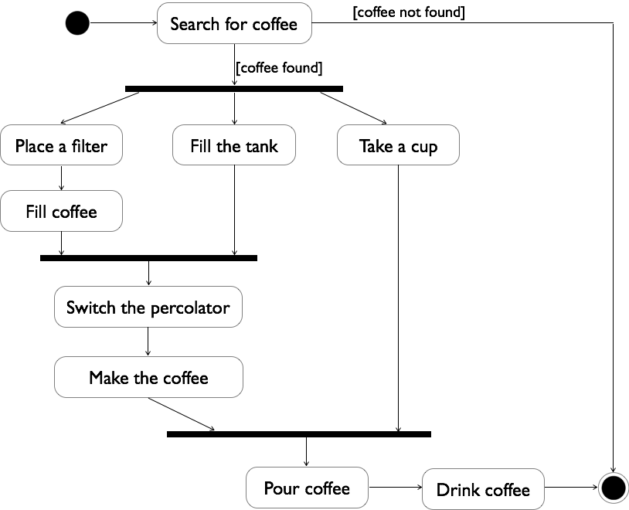


Introduction to UML: activity diagram
Describing the information flows in the system
Modeling the dynamic view of the system
Example: Making coffee

Slide 28

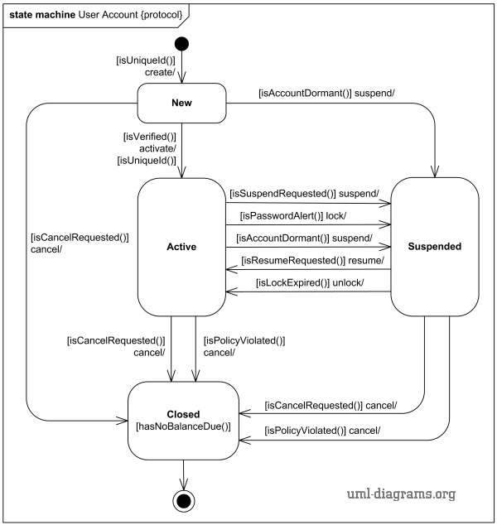
Introduction to UML: state diagram
Describing the internal behaviour of the system
Modeling the dynamic view of the system
Example
“Online Shopping Account” State Diagram

Slide 29
Introduction to UML: Package diagrams
Packages
  Universal element is used to organize classes, or some other group into a group
Package diagrams
  Displays packages and the relationships between packages.
  Example
System
Client
Product
Interface
DB

Slide 30
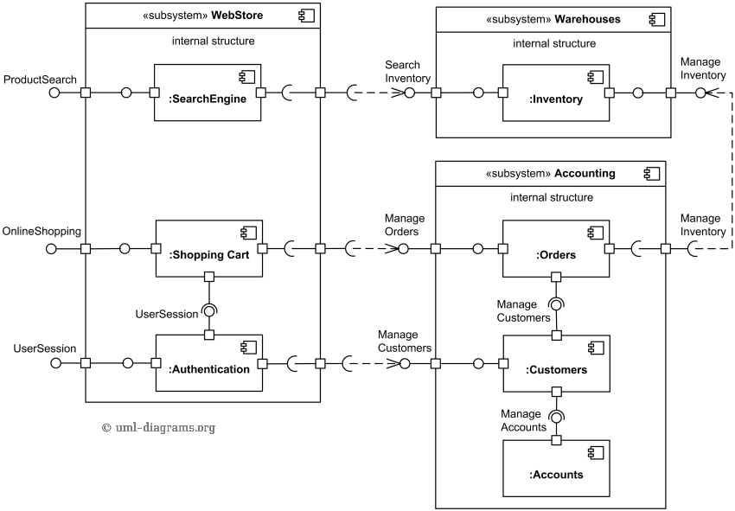
Introduction to UML: component diagrams
Describe the organisation of different components of the system
The static view of the organisation of the system
Example
“Online Shopping Website” Component Diagram

Slide 31
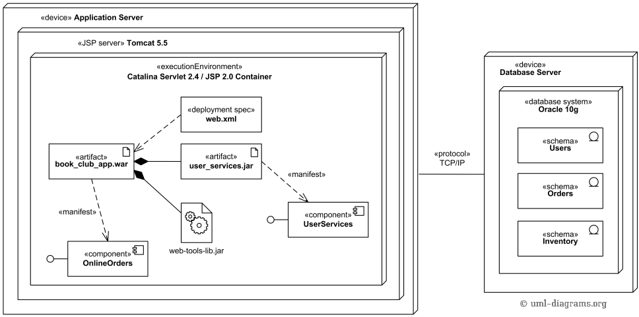
Introduction to UML: deployment diagrams
Describing the physical organisation of different components (machines) of the system (material)
An example of deployment diagram of JEE web application

Slide 32
Introduction to UML: extension mechanism
Built-in extension mechanism
  Stereotypes
  Tagged values
Notes
Constraints
  OCL textual language

Slide 33
Introduction to UML: general mechanisms
Stereotype
  is a built-in extension mechanism
  expands the vocabulary of UML
  is used to create new types of UML elements that derive from the existing kinds but which are adapted to a given problem
  there are predefined stereotypes in UML
  Notation
    “name of stereotype”
    Possibility to introduce an icon
« Actor »
Customer
« utility »
Maths
Customer
« subsystem »
User Interface
« datatype »
Float

Slide 34
Introduction to UML: general mechanisms
Tagged values
  Another extension mechanism
  Provide additional information on the elements of UML
  Pairs of type {name = value}
  Example
Class
{author = NTB,
version = 2.0}

Slide 35
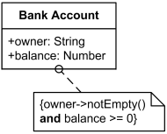

Introduction to UML: general mechanisms
Notes
  are comments attached to one or more modeling elements
  provide additional information on modeling elements
  belong to the view, not the models

Slide 36
Introduction to UML: general mechanisms
Constraints
  are restrictions that limit the use of an element or the element semantic
  are expressed in natural language
  are expressed in OCL (Object Constraint Language)
  Example
Rectangle
BankAccount
width:int {width > 0}
height:int {height > 0}
{xor}
Individual
Organism

Slide 37
Introduction to UML: views
A system is modelled by 5 different views in the UML
Static view
Architectural view
User Views
Dynamic view
Deployment view

Slide 38
Introduction to UML: views
Diagrams and views
Static view
Class diagrams
Object diagrams
Architectural view
Package diagrams
Component diagrams
Users view
Use-case diagrams
Dynamic view
Interaction diagrams
State diagrams
Activity diagrams
Deployment view
Deployment diagrams

